Slide 1






A new generation
of tech specialists

Slide 2
AI HEALTH COMPANION
FOR UNIVERSITY STUDENTS
Presented By : GROUP 7
Frontier Tech Leaders | 2025

Slide 3
OVERVIEW
BACKGROUND AND OBJECTIVE
SDG RELATION
PROJECT ELEMENT
ROADMAP
PROJECT DEVELOPMENT
PROJECT COST
CONCLUSION & FRAMEWORK

Slide 4
Background & Objective
Quick QUESTION?

Slide 5
IMPORTANCE OF THE PROBLEM BEING SOLVED:
Mental health challenges are prevalent among university students,but are rarely worked on; with many facing stress, anxiety, depression, and other issues during their academic journey.
Stigma and lack of access to mental health resources often hinder students from seeking support.
This project seeks to address this problem by offering students a stigma-free, confidential, and easily accessible platform to receive personalized support, crisis helplines, and peer interaction, helping reduce the barriers to mental health care.

Slide 6
Project Element
AI Chatbot (Core Feature)
Safe Space Community Support Platform
Crisis Helplines
Curated Self-Help Resources

Slide 7
OUR GOAL
To make a mental health support
accessible,judgment-free and
available 24/7

Slide 8
Project Development
Frontend Design
AI Chatbot Interface
Community Forum
Crisis Helplines Access
Self-Help Resource
Backend Development
AI Chatbot Integration
User Authentication
Data Management
Resource Management
Integrate Backend with Frontend

Slide 9
RoadMap
Phase 1 - Ideation & Setup
Define User Journey
Chatbot Workflow
Set Up GitHub Repo
Phase 2 - Frontend Development
Chatbot UI
Community Discussion Page
Phase 3 - Backend Development (Day 2-3)
Develop Backend
Resource Links
Phase 4 – Integrate Backend with Frontend (Day 3)
Connect UI & Backend
Phase 5-Testing & Deployment (Day 3)

Slide 10
SDG Relation
SDG 3: Good Health and Well-being

Slide 11
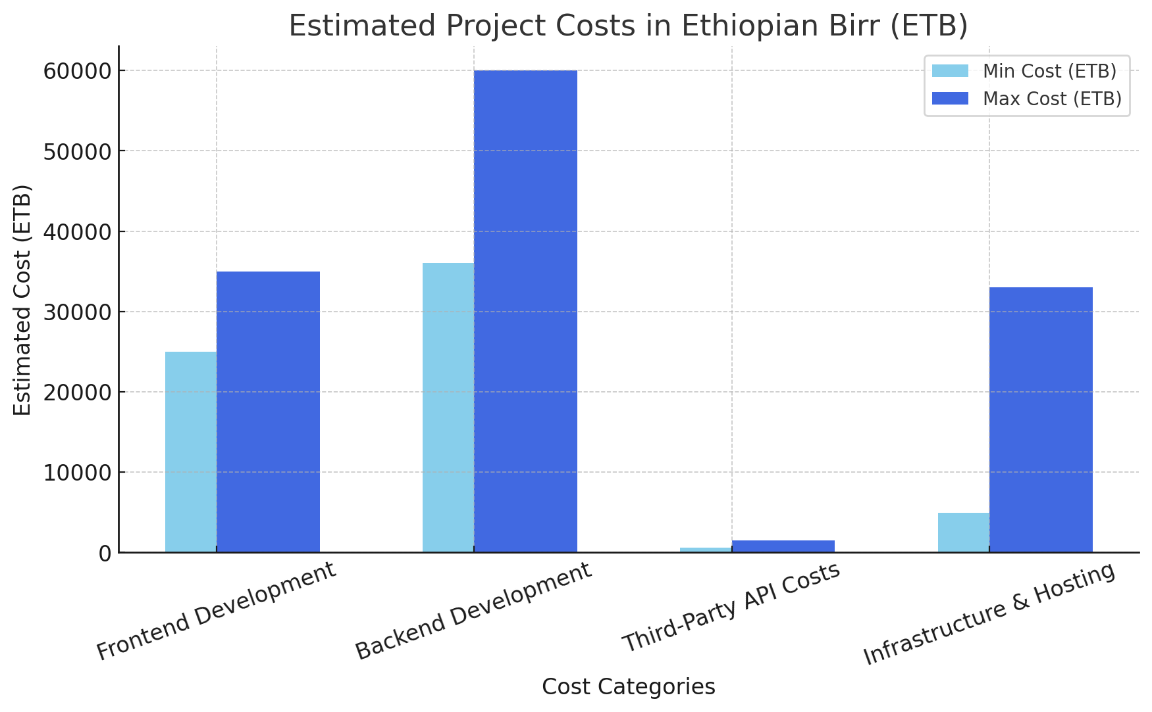
Project Cost
-

Slide 12
Conclusion and Futurework
Conclusion
Critical need in supporting student mental health
AI-driven chatbots
Peer support forums
Curated self-help resources
Crisis helplines
Empowers students to manage their mental health
Futurework
Expansion of Features
Advanced AI Models
Personalized Mental Health Plans
Mental Health Tracking
Integration with University Systems
Real-Time Counseling Scheduling

Slide 13


Thank you!

